Slide 1
Deep-Q: Traffic-driven QoS Inference using Deep Generative Network

Slide 2
Introduction
SLA guarantee needs
Real-time QoS monitoring
Goal: inference a QoS metric (random variable)
Use-cases are both for online and offline applications
Need of modeling. Deep RL not applicable
Conventional methods:
queuing modeling with simplified assumptions
Simulations (take time!)

Slide 3
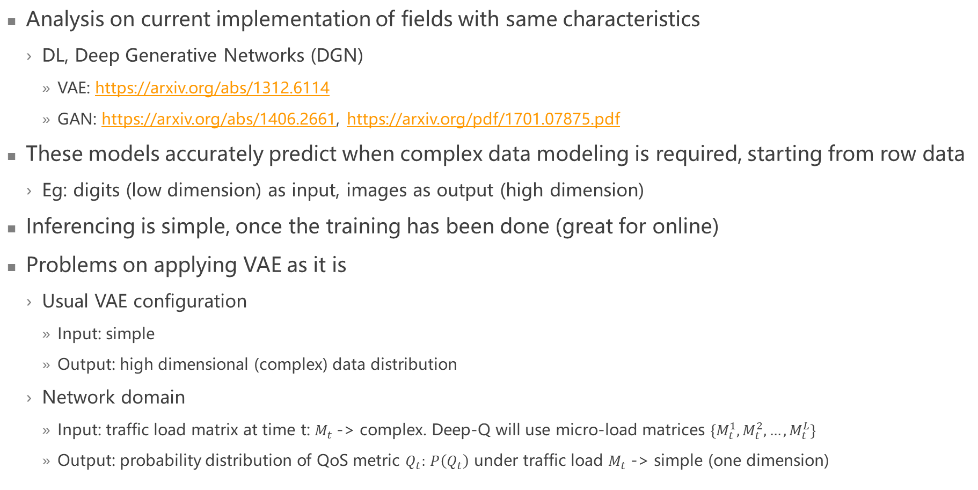
State-of-the-art
Analysis on current implementation of fields with same characteristics
DL, Deep Generative Networks (DGN)
VAE: https://arxiv.org/abs/1312.6114
GAN: https://arxiv.org/abs/1406.2661, https://arxiv.org/pdf/1701.07875.pdf
These models accurately predict when complex data modeling is required, starting from row data
Eg: digits (low dimension) as input, images as output (high dimension)
Inferencing is simple, once the training has been done (great for online)
Problems on applying VAE as it is
Usual VAE configuration
Input: simple
Output: high dimensional (complex) data distribution
Network domain
Input: traffic load matrix at time t: $M_{t}$-> complex. Deep-Q will use micro-load matrices $\left\{M_{t}^{1},M_{t}^{2}, …,M_{t}^{L}\right\}$
Output: probability distribution of QoS metric $Q_{t}:$ $P\left(Q_{t}\right)$ under traffic load $M_{t}$ -> simple (one dimension)

Slide 4
Main contributions of the article
Input adjustment to VAE setting
Output adjustment to VAE setting
Cinfer-loss module to compute an approximation of the error
Accurate in this context
Fast to support online inference

Slide 5
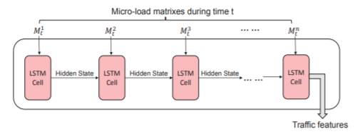
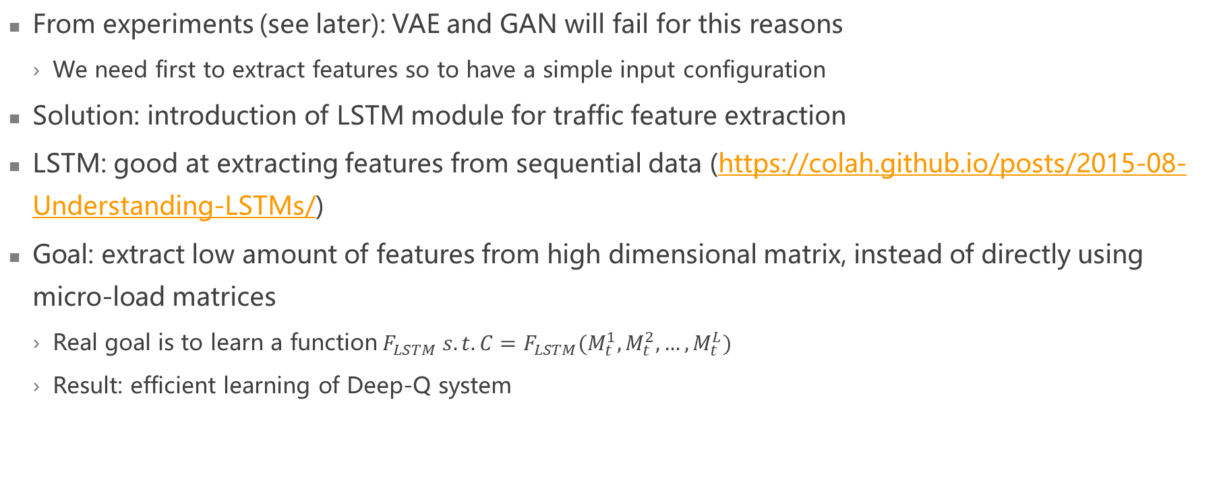
Input adjustment to VAE settings
From experiments (see later): VAE and GAN will fail for this reasons
We need first to extract features so to have a simple input configuration
Solution: introduction of LSTM module for traffic feature extraction
LSTM: good at extracting features from sequential data (https://colah.github.io/posts/2015-08-Understanding-LSTMs/)
Goal: extract low amount of features from high dimensional matrix, instead of directly using micro-load matrices
Real goal is to learn a function$F_{LSTM} s.t. C=F_{LSTM}(M_{t}^{1},M_{t}^{2}, …,M_{t}^{L})$
Result: efficient learning of Deep-Q system
Representation of how features are extracted each time considering the micro-load matrices

Slide 6
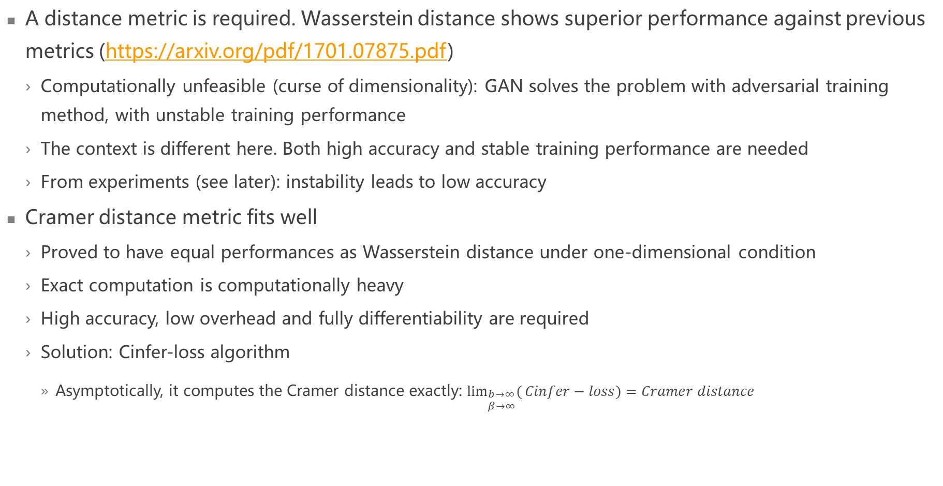
Output adjustment to VAE settings
A distance metric is required. Wasserstein distance shows superior performance against previous metrics (https://arxiv.org/pdf/1701.07875.pdf)
Computationally unfeasible (curse of dimensionality): GAN solves the problem with adversarial training method, with unstable training performance
The context is different here. Both high accuracy and stable training performance are needed
From experiments (see later): instability leads to low accuracy
Cramer distance metric fits well
Proved to have equal performances as Wasserstein distance under one-dimensional condition
Exact computation is computationally heavy
High accuracy, low overhead and fully differentiability are required
Solution: Cinfer-loss algorithm
Asymptotically, it computes the Cramer distance exactly: $\lim_{\begin{aligned}b→∞ \\ β→∞\end{aligned}}({Cinfer−loss)=Cramer distance}$

Slide 7
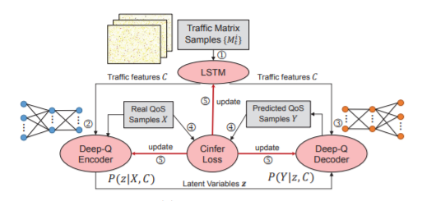
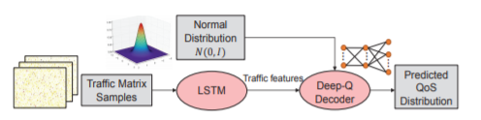
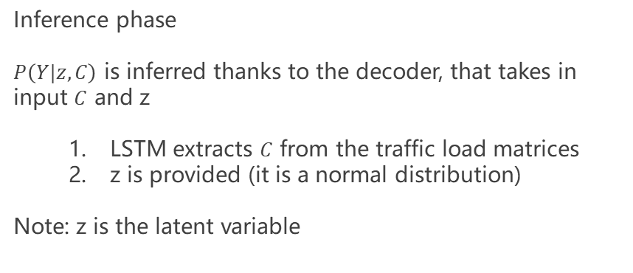
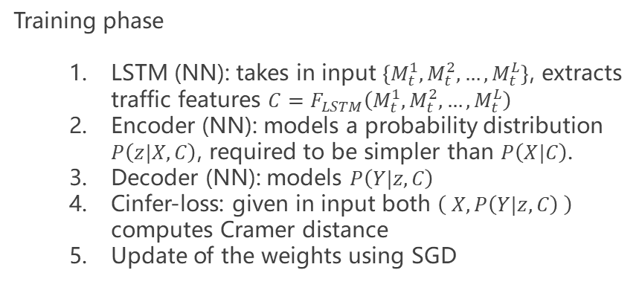
Advanced description of the work
Training phase
LSTM (NN): takes in input $\left\{M_{t}^{1},M_{t}^{2}, …,M_{t}^{L}\right\}$, extracts traffic features $C=F_{LSTM}\left(M_{t}^{1},M_{t}^{2}, …,M_{t}^{L}\right)$
Encoder (NN): models a probability distribution $P\left(z|X,C\right)$, required to be simpler than $P\left(X|C\right)$.
Decoder (NN): models $P\left(Y|z,C\right)$
Cinfer-loss: given in input both $\left( X, P\left(Y|z,C\right) \right)$ computes Cramer distance
Update of the weights using SGD
Inference phase
$P\left(Y|z,C\right)$ is inferred thanks to the decoder, that takes in input $C$ and z
LSTM extracts $C$ from the traffic load matrices
z is provided (it is a normal distribution)
Note: z is the latent variable

Slide 8
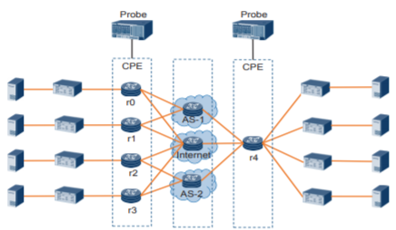
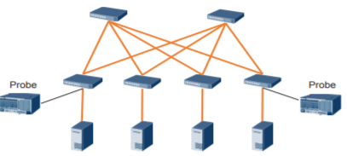
Simulations (1/3)
The dataset was obtained by considering data coming from real networking usages
Training: 24h traffic trace
Test: 24h traffic trace
Two HW setups have been used to show the strength of the algorithm regardless the network, and congestion has been forced (limit bandwidth)
Data center network
Overlay IP network

Slide 9
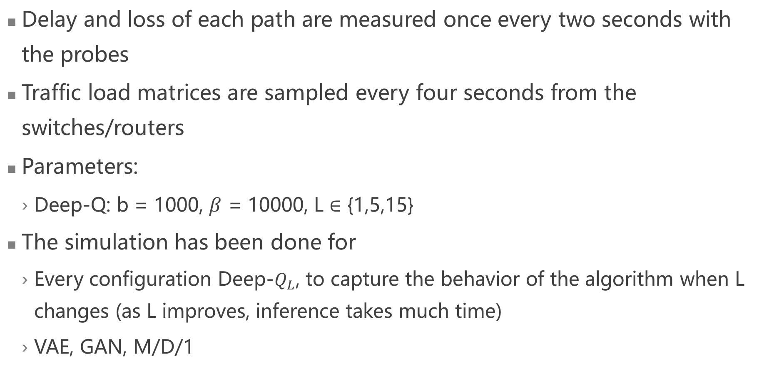
Simulations (2/3)
Delay and loss of each path are measured once every two seconds with the probes
Traffic load matrices are sampled every four seconds from the switches/routers
Parameters:
Deep-Q: b = 1000, $β$ = 10000, L $∈$ {1,5,15}
The simulation has been done for
Every configuration Deep-$Q_{L}$, to capture the behavior of the algorithm when L changes (as L improves, inference takes much time)
VAE, GAN, M/D/1

Slide 10
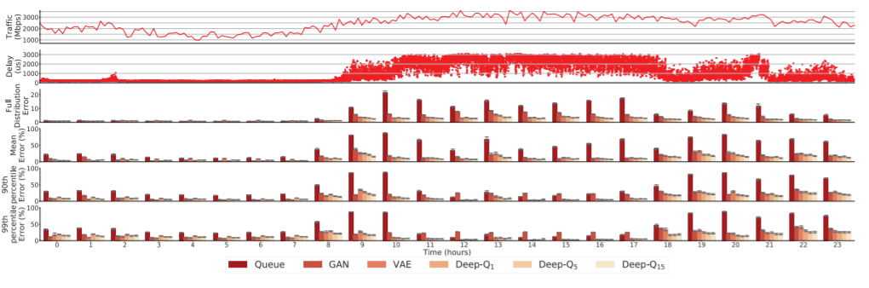
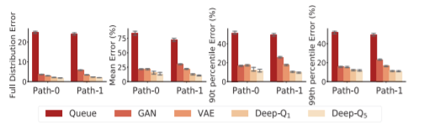
Simulations (3/3)
DCN
For each hour (mean of the 60 values sampled for each minute), it is shown the traffic, the delay and the inferences error on delay for all the models. In details, error are in the form of
Full distribution error
Mean error
90th percentile error
99th percentile error
Overlay IP
The errors are shown in the same form, but considering the packet loss rate

Slide 11
Results
Analyzing DCN results
Inference errors are generally low for low loads
Inference errors increase in case of medium and higher loads
Deep-Q is the one that reacts better to these configurations
The intuition that GAN is improved because instability training is removed is confirmed
The intuition that VAE is improved is confirmed
L must be considered as a parameter of performance. The higher, the better the algorithm it performs, but L=5 and L=15 provide similar results -> convergency is reached for those values in these configurations
Analyzing Overlay IP network
Results are similar to DCN, so the algorithm seems to be robust to topological changes

Slide 12
Conclusions
Multi-hop networks may become problematic
More complex models required for modeling probability distribution of QoS metrics
Queuing models are way too approximate in case of medium and high congestion
Deep learning techniques may be helpful, but current state-of-the-art techniques need an improvement if applied to estimation of QoS
Deep-Q is a solution to all these problems
High improvement on every aspect

Slide 13
Strengths and falls
Strenghts
High accuracy
Low inference time
Online optimization is achievable
Tried on two different network configurations and it worked well
Falls
Dependence on QoS measurements
Required offline training
No prove that it does not depend on the network configuration
No routing policy assumption
Lack of online training means no adaptation to changes
Chance to find correct trade-off between inference time and loss (L)
Intuition that a change of L is required if the network is improved

Slide 14
Improvements
Analyze whether different configurations could lead to different results
If so
First try: train the model with data obtained from more configurations. A possible result could be that the algorithm is not precise anymore as the model becomes too complex.
If so, either collect more data or (curse of dimensionality) collect data of networks in different configurations so that to find a possible clustering of the configurations (in the sense that we cluster them depending on the traffic loads). Then, train a model for each cluster and try to learn also the belonging of the matrix to one of these clusters.
An analyses on how L parameter should be set depending on the network configuration is crucial to understand the scalability of the algorithm, as higher L implies higher inference time
Initially apply an offline training (depending on the feasibility), and add an online learning mechanism
Improves adaptability over time

